Slide 1

DroneRanger: Vision-Driven Deep Learning for Drone Distance Estimation
Hamid Azad¹, Varun Mehta², Iraj Mantegh², Miodrag Bolic¹
¹: School of Electrical Engineering and Computer Science (SEECS), University of Ottawa, Ottawa, ON., Canada
²: National Research Council Canada (NRC), Montreal, QC., Canada

Slide 2
Content
Introduction
Problem definition
Proposed method (DroneRanger)
Performance analysis
Conclusion & Future works

Slide 3
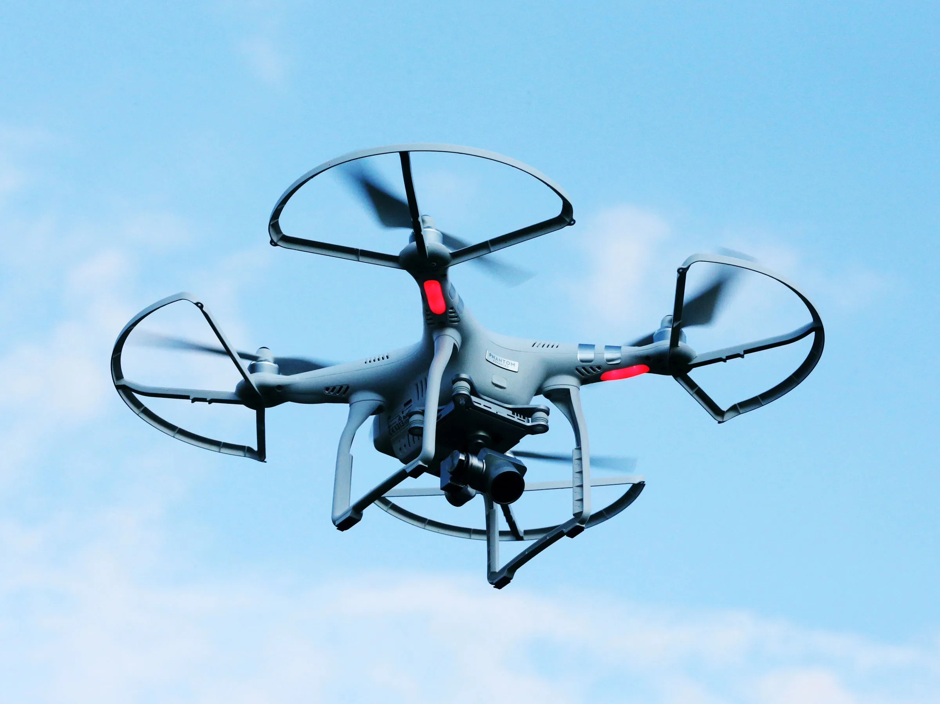
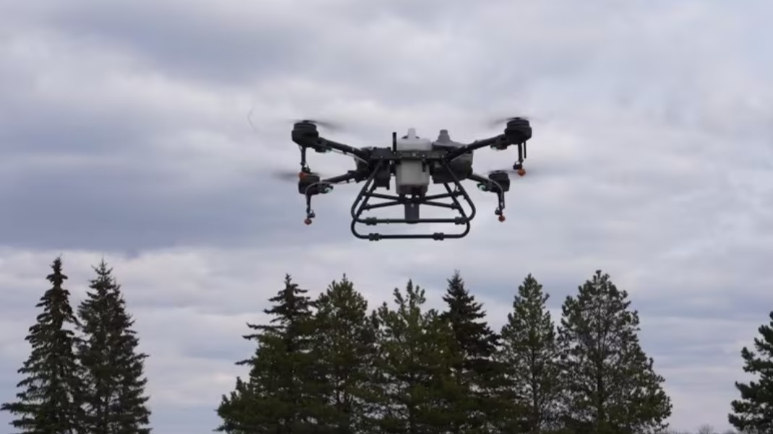
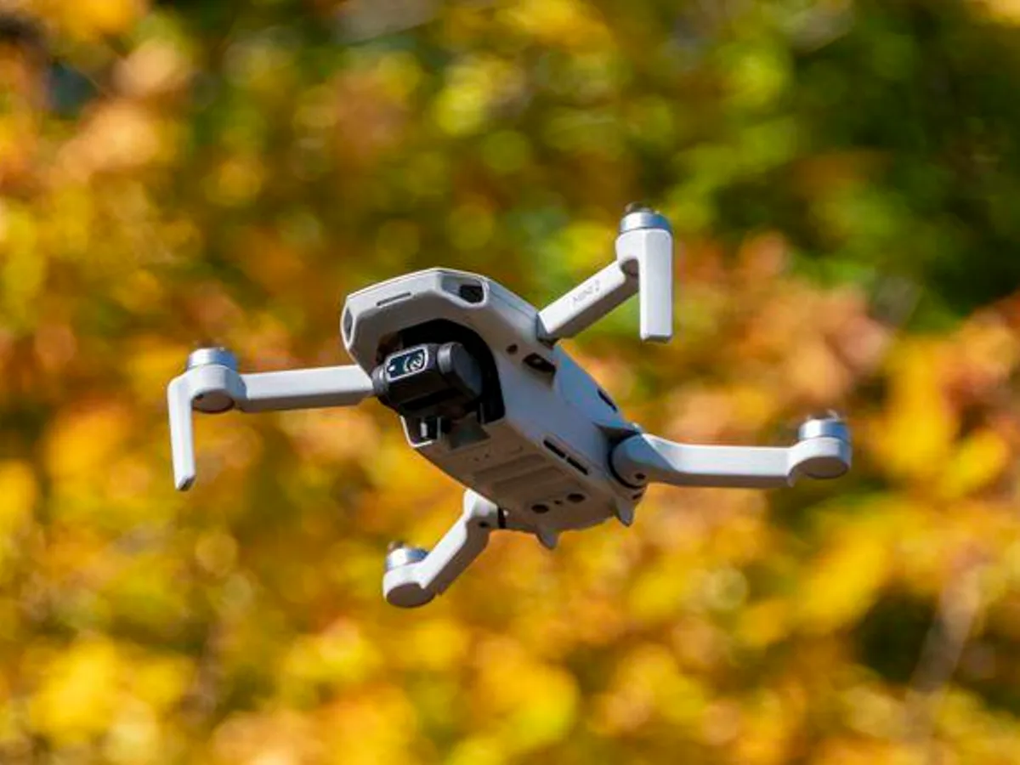
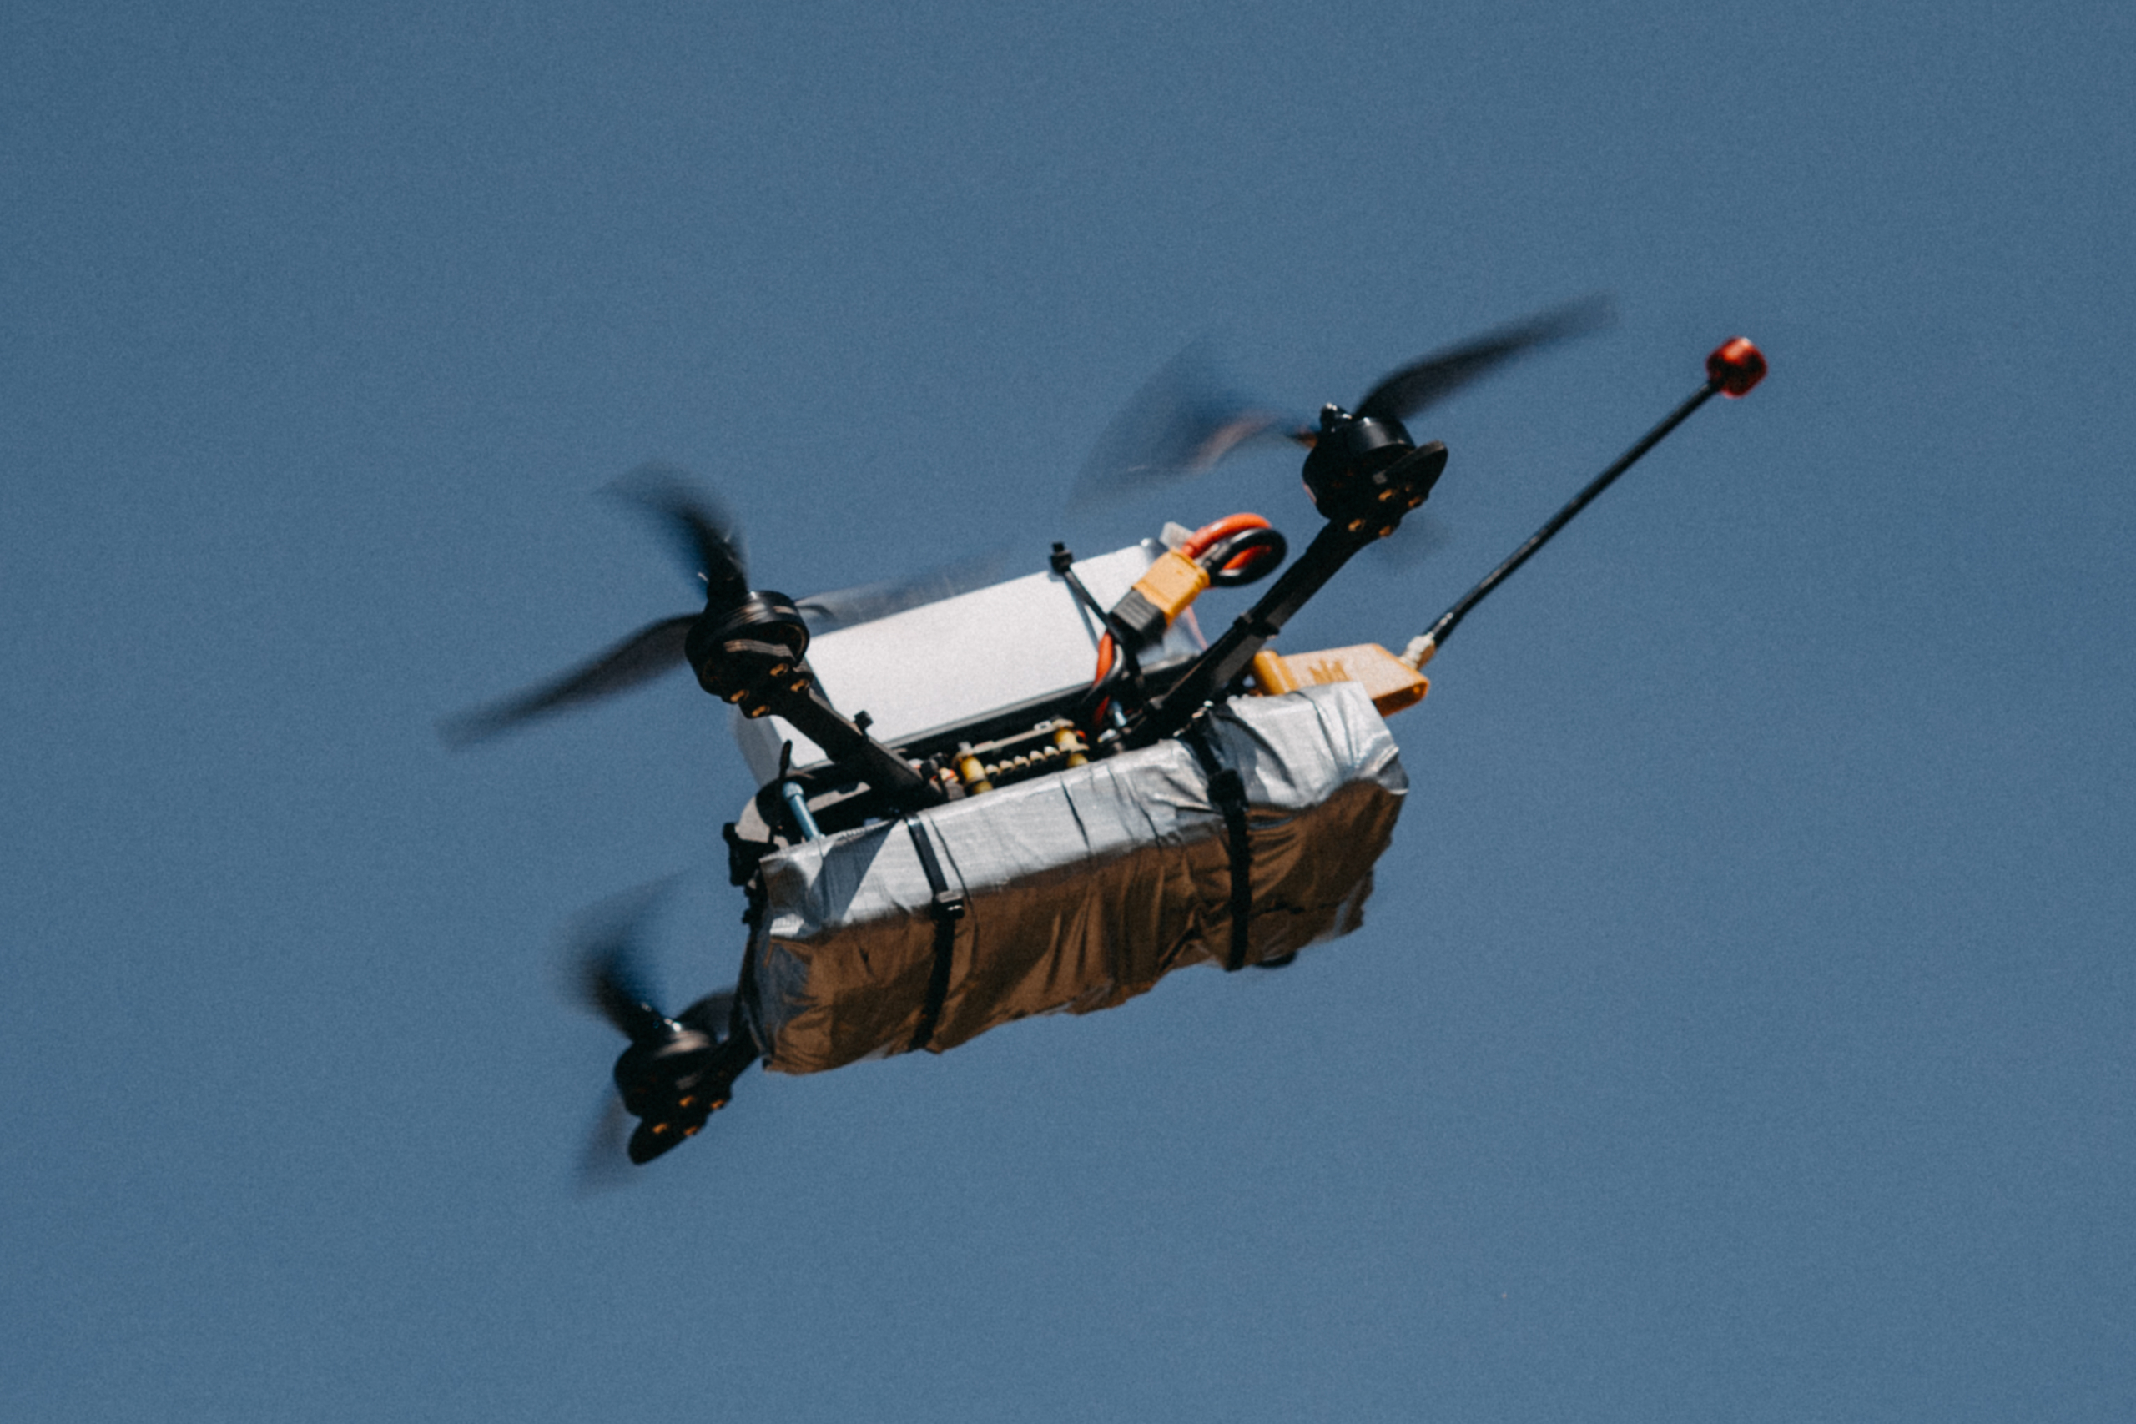
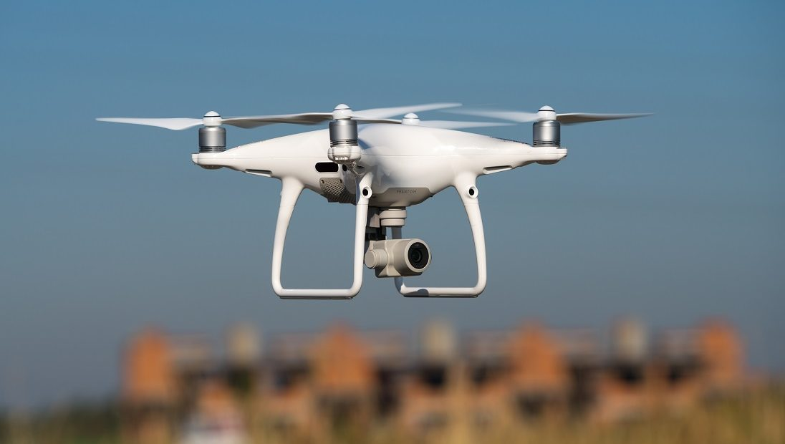
Introduction
Vast usage of UAVs in applications e.g. cargo transport, aerial photography, border security
Serious concerns about safety and security issues. Threats such as transporting smuggled goods and Illegal entry to restricted areas
The importance of counter-UAV measures, including detection, and localization of UAVs
Vision-based localization methods rely on visual information to determine the drone's position accurately
The inherent loss of depth information in 2D representations, compounded by factors like perspective distortion and lighting
Innovative deep learning-based approaches for accurate distance estimation in drone localization
Introduction
Problem definition
Proposed method
Performance analysis
Conclusion & future works

Slide 4
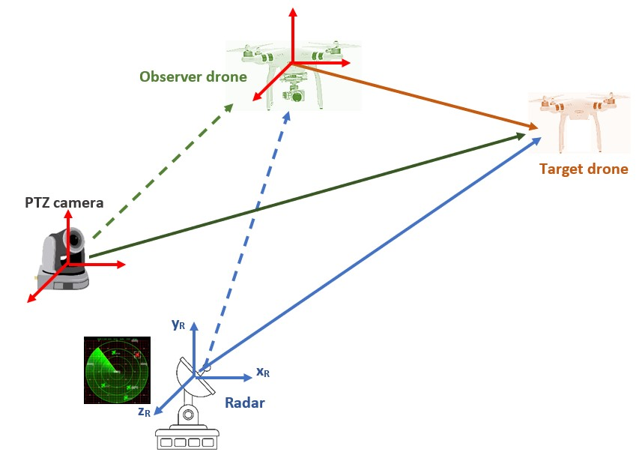
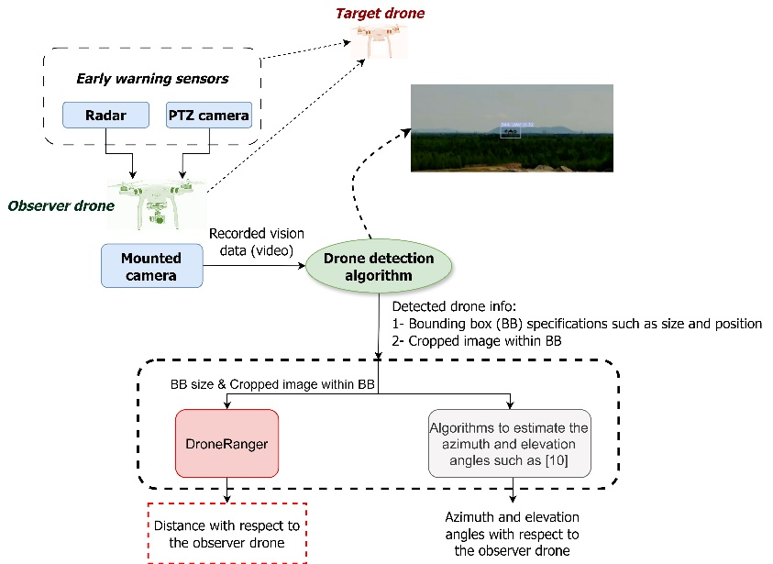
Problem definition
Motivation and problem statement
Multi-sensor counter-UAV system
Radar and PTZ camera as early warning sensors to identify drone
Mounted camera on the observer drone
Detection step done using a previously trained YOLO-v5 network (beyond the scope of this work)
Localization of the target drone using the camera
Introduction
Problem definition
Proposed method
Performance analysis
Conclusion & future works
Notes:
Azimuth and elevation angles can be estimated using the classical pinhole model
[YOLOref] F. Dadboud, V. Patel, V. Mehta, M. Bolic, and I. Mantegh, “Singlestage uav detection and classification with yolov5: Mosaic data augmentation and panet,” in 2021 17th IEEE International Conference on Advanced Video and Signal Based Surveillance, 2021, pp. 1–8.

Slide 5
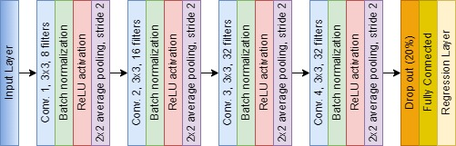
Proposed method
DroneRanger
CNN-based distance regressor architecture
Four convolutional layers, each followed by batch normalization, ReLU activation, and average pooling
Three types of input and two forms of loss function
Introduction
Problem definition
Proposed method
Performance analysis
Conclusion & future works

Slide 6
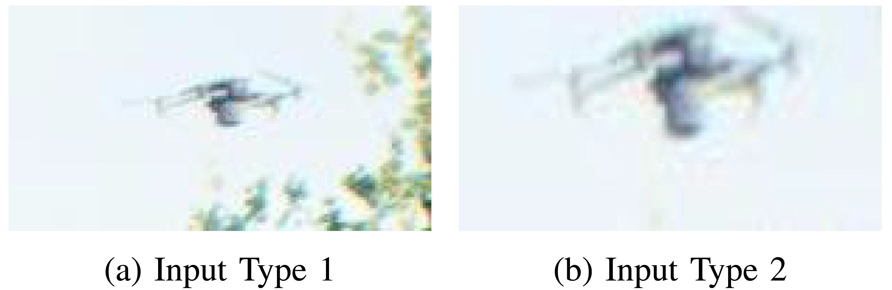
Proposed method (cont’d)
Three input types
Input Type 1: A fixed-size rectangular area measuring VxH pixels is cropped around the center of the bounding box.
Input Type 2: Resized cropped version of the bounding box area to the fixed size of VxH pixels (Bicubic interpolation for resizing)
Input Type 3: Input Type 2 + the width and height of the bounding box in pixels
Introduction
Problem definition
Proposed method
Performance analysis
Conclusion & future works
Notes:
Input Type 1: keeps the actual size of the target drone in the image frame, but includes more details of the background (see the figures) which may affect the performance of the algorithm (as will be shown in the simulation results).
Input Type 2: just keeps the bounding box area but resize it. Although we don’t have the background details as much as the Input Type 1, because of resizing to a fixed size, the information about the actual size of the drone will be lost. Given that this size information is indicative of the drone’s distance to the camera (farther drones appear smaller in the captured image), we lost this important feature in this type of input.
Input Type 3: try to address the issue with the Input Type 2 by feeding the actual size of the bounding box in addition to the resized bounding box

Slide 7
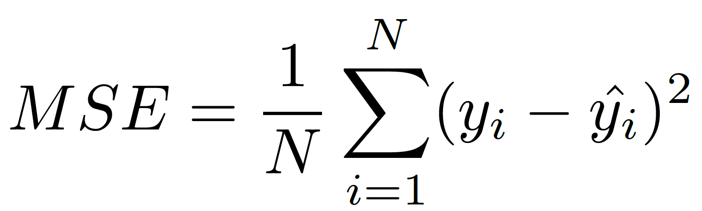
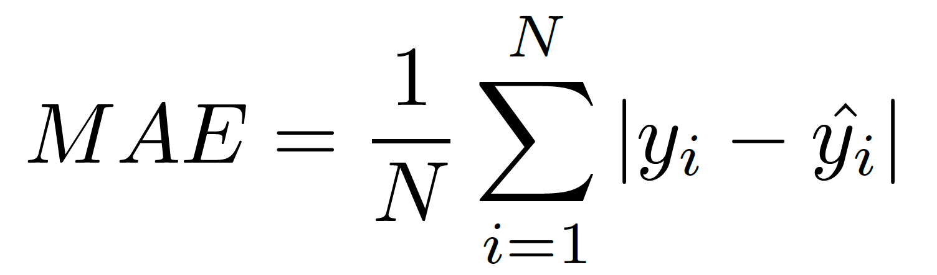
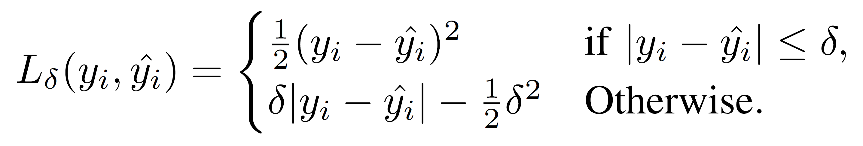
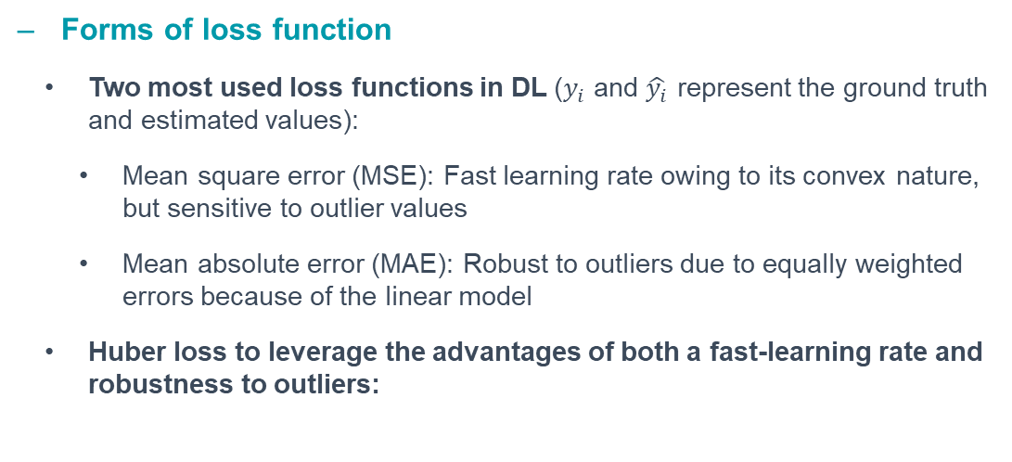
Proposed method (cont’d)
Forms of loss function
Two most used loss functions in DL ($y_{i}$ and $\hat{y_{i}}$ represent the ground truth and estimated values):
Mean square error (MSE): Fast learning rate owing to its convex nature, but sensitive to outlier values
Mean absolute error (MAE): Robust to outliers due to equally weighted errors because of the linear model
Huber loss to leverage the advantages of both a fast-learning rate and robustness to outliers:
Introduction
Problem definition
Proposed method
Performance analysis
Conclusion & future works
Notes:
MSE: because of the square (or quadratic) form, the loss is sensitive to outliers for which we have larger errors.
MAE: doesn’t have the quadratic form (more robust to outliers) but at the same time, does not have a fast learning rate
Huber loss [*]: when the error is less than a threshold (i.e., not an outlier), uses MSE form and for larger errors (i.e., outliers), MAE form is utilized
[*]: Huber, Peter J. "Robust estimation of a location parameter." In Breakthroughs in statistics: Methodology and distribution, pp. 492-518. New York, NY: Springer New York, 1992.
It is closely related to “smooth L1 loss”: smoothL1Loss=HuberLoss/delta (Huber divided by delta) but they have different behavior for very small and very large values of delta—You can ignore this sentence in the presentation, this is just for your information

Slide 8
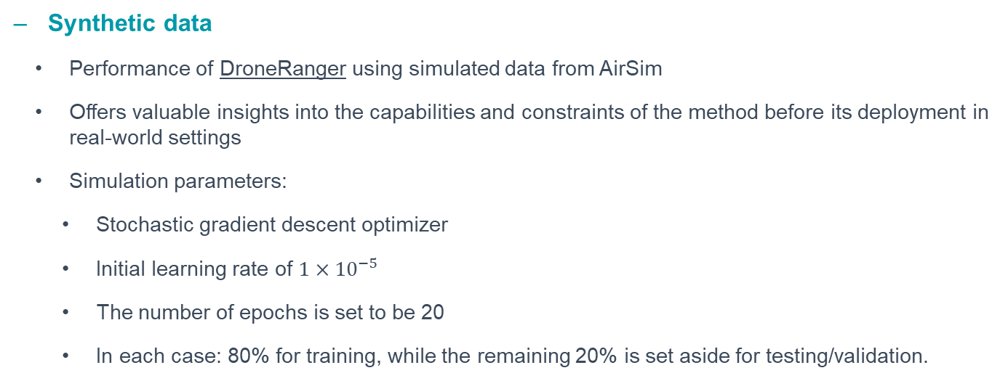
Performance analysis
Synthetic data
Performance of DroneRanger using simulated data from AirSim
Offers valuable insights into the capabilities and constraints of the method before its deployment in real-world settings
Simulation parameters:
Stochastic gradient descent optimizer
Initial learning rate of $1×{10}^{−5}$
The number of epochs is set to be 20
In each case: 80% for training, while the remaining 20% is set aside for testing/validation.
Introduction
Problem definition
Proposed method
Performance analysis
Conclusion & future works

Slide 9
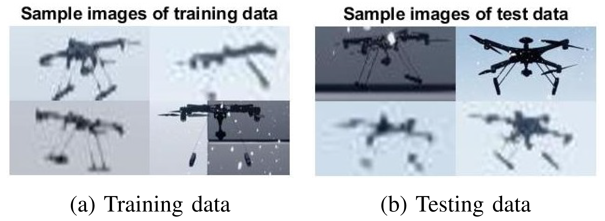
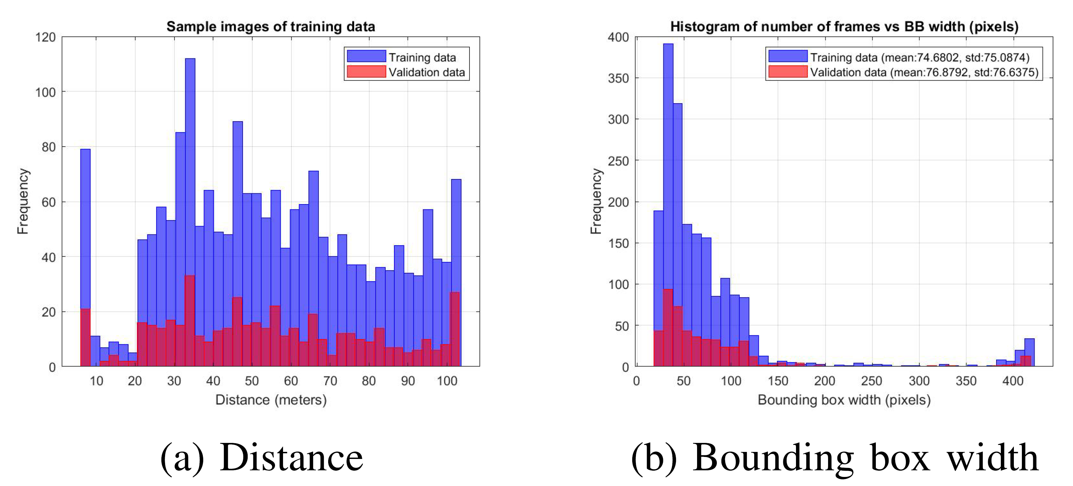
Performance analysis (cont’d)
Test #1
Basic scenario featuring one type of drone across different weather conditions
A Quadrotor model is simulated in the Blocks environment – commercial UAV (ARA Robotics)
Sunny, rainy, and snowy weather conditions
Around 800 samples in each condition (equivalent to 1920 and 480 samples for the training and testing phases, respectively)
RMSE of distance estimation error for the three input types are 5.89, 5.87, and 3.49 meters, respectively.
Introduction
Problem definition
Proposed method
Performance analysis
Conclusion & future works

Slide 10
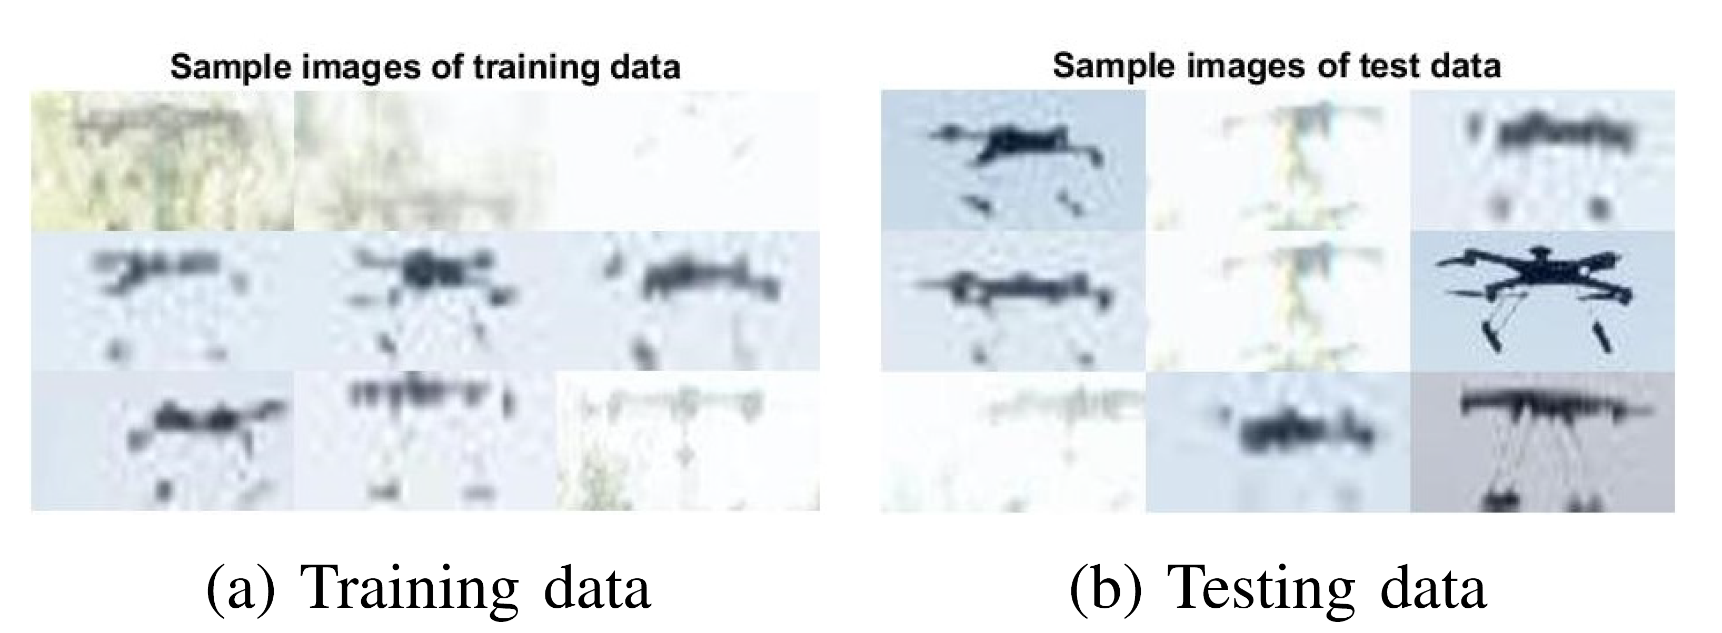
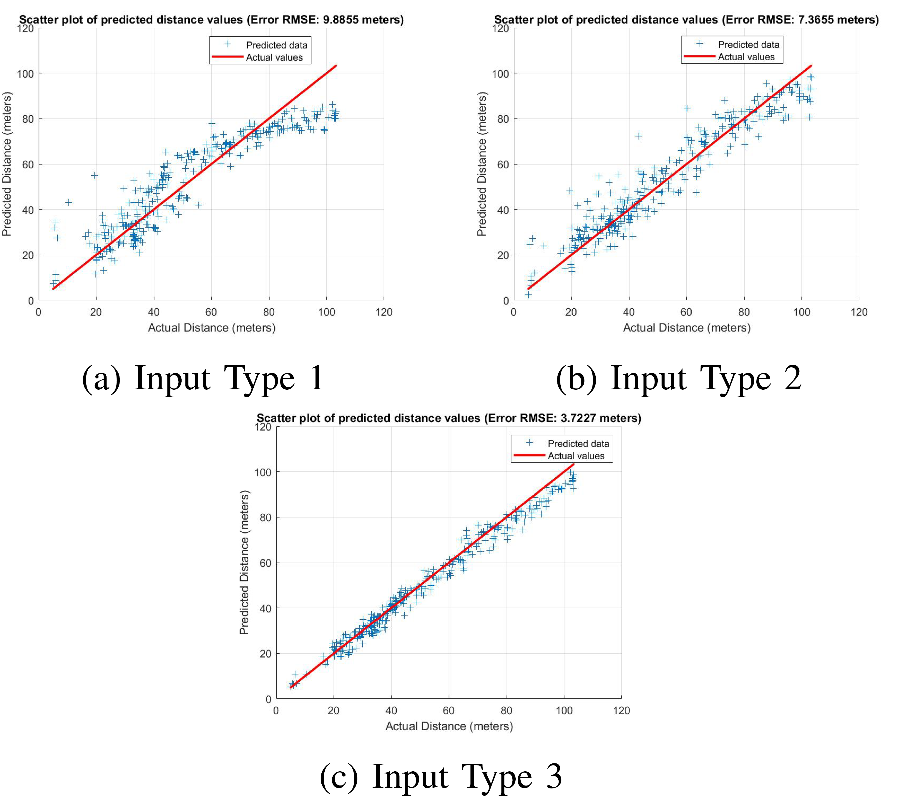
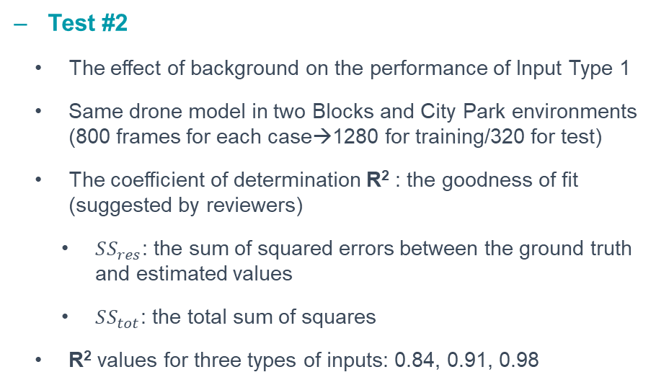
Performance analysis (cont’d)
Test #2
The effect of background on the performance of Input Type 1
Same drone model in two Blocks and City Park environments (800 frames for each case→1280 for training/320 for test)
The coefficient of determination R² : the goodness of fit (suggested by reviewers)
$SS_{res}$: the sum of squared errors between the ground truth and estimated values
$SS_{tot}$: the total sum of squares
R² values for three types of inputs: 0.84, 0.91, 0.98
Introduction
Problem definition
Proposed method
Performance analysis
Conclusion & future works
Notes:
Test #1: samples from the Blocks environment (mostly sky background)
In environments with backgrounds other than blue sky, the extended bounding box area contains significantly varying backgrounds
-Potentially degrades the performance in the Input Type 1 case
Better performance seen for Input Type 2 compared to Type 1 as expected
Similar to Test #1: better results for Input Type 3 compared to Type 2

Slide 11
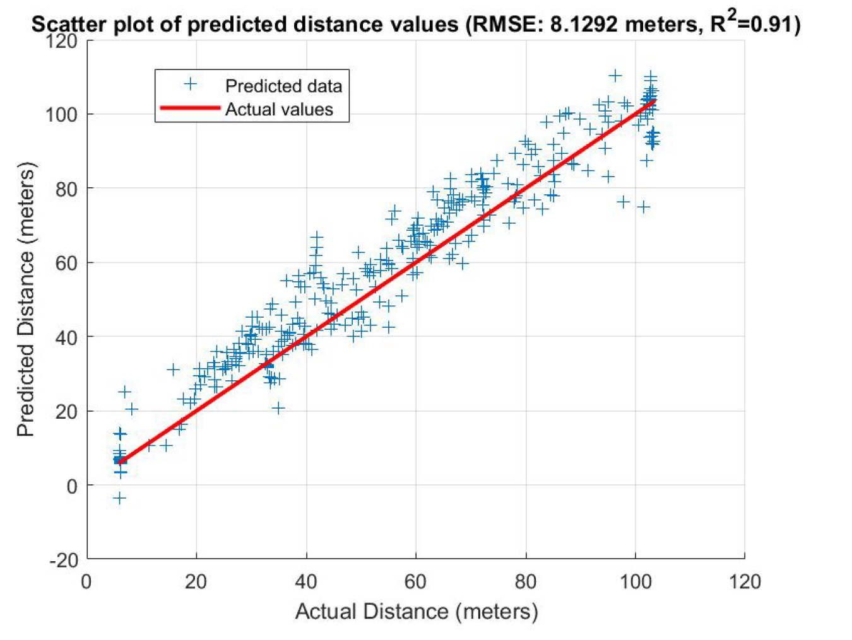
Performance analysis (cont’d)
Test #3
The performance of the CNN regression network on unseen data (Domain shift-drone model)
Trained using ARA quadrotor and DJI Mavic drones but tested on a dataset recorded with DJI FPV (imported original 3D object into AirSim/1600 frames for training & 800 for test)
The value of R² (i.e., 0.91) shows the goodness of fitted data
Introduction
Problem definition
Proposed method
Performance analysis
Conclusion & future works
Notes:
The original 3D object format: gld format

Slide 12
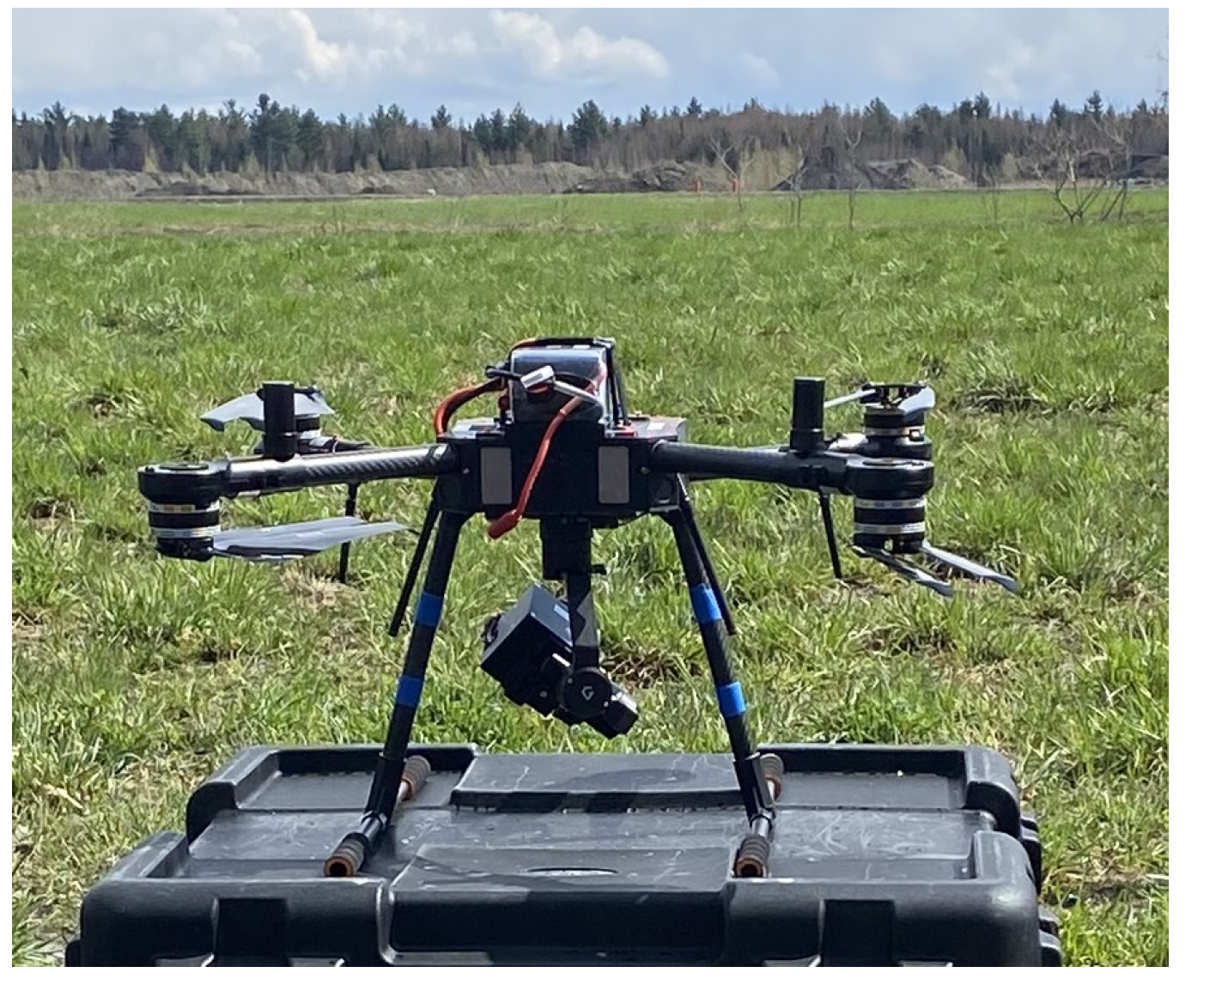
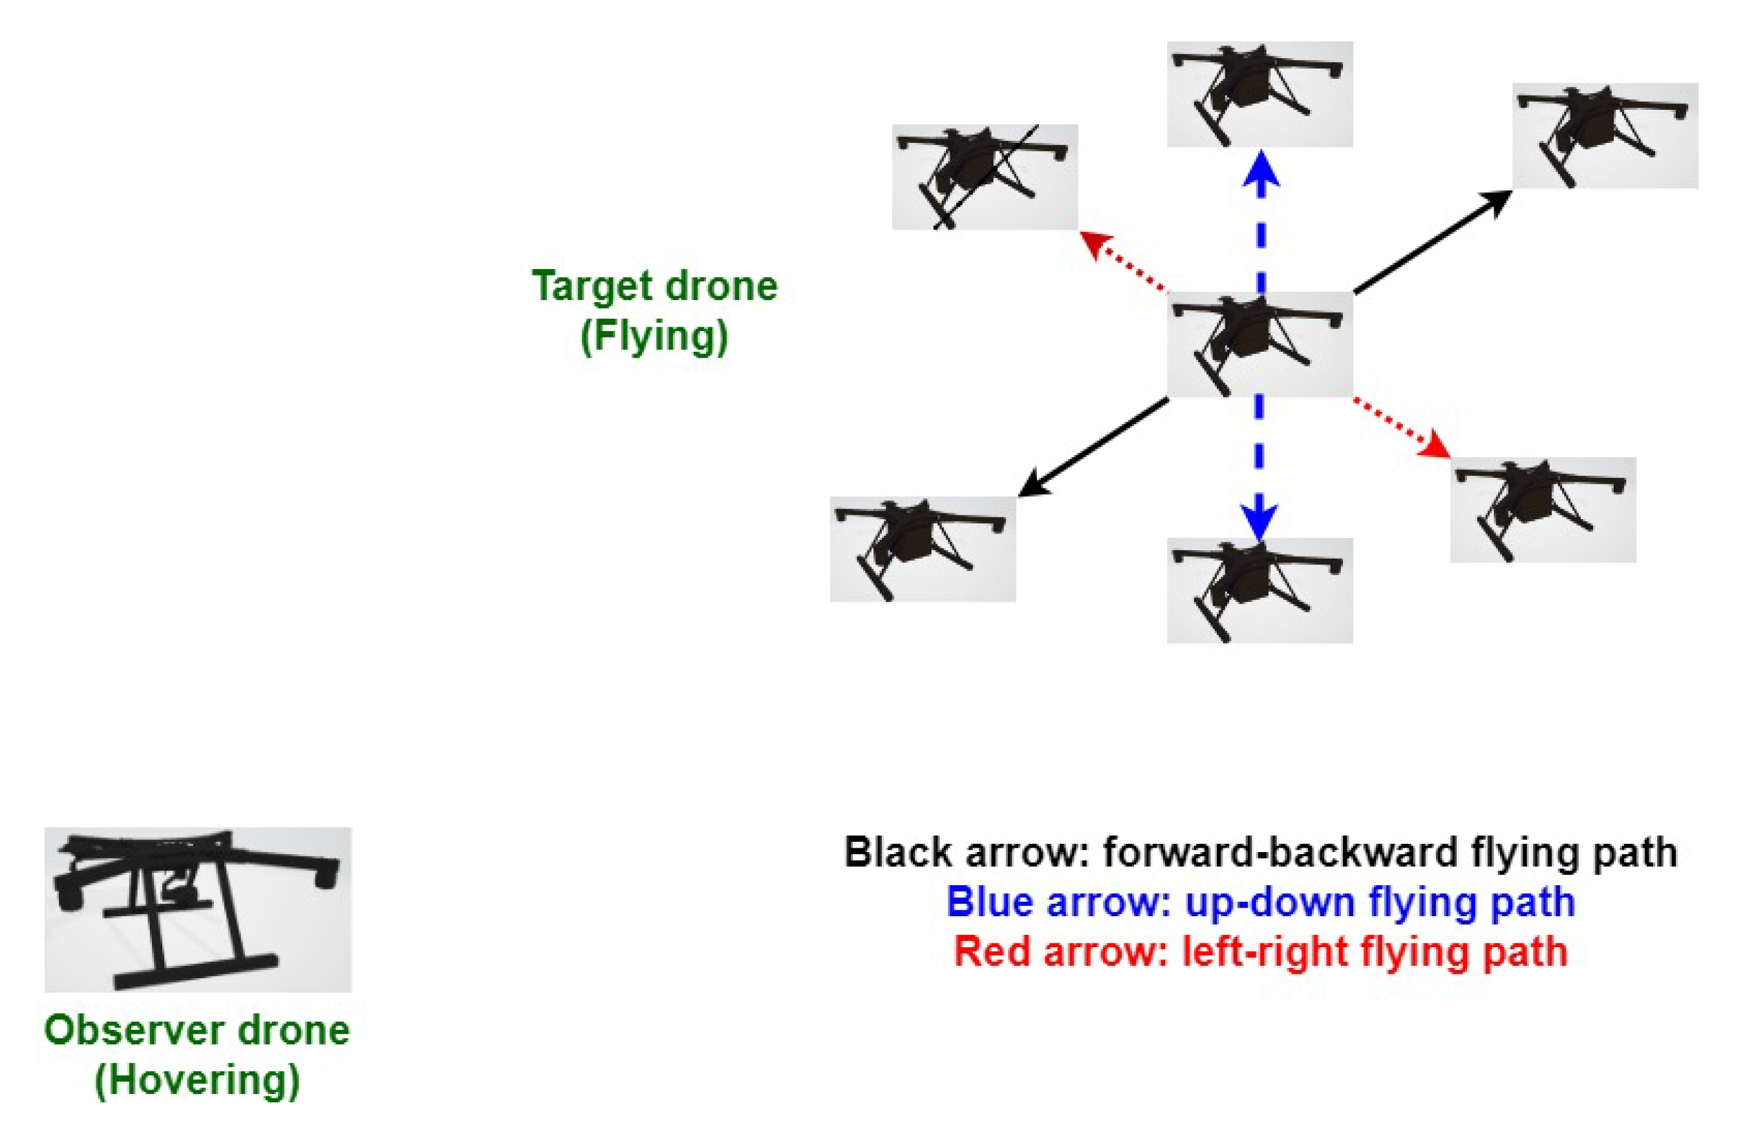
Performance analysis (cont’d)
Experimental data
A quadrotor drone (model 408 from ARA Robotics) equipped with a camera to capture images of the target
FoV of 62.7 degree
Resolution of 1080*1920 pixels
30 frames per second
Another quadrotor drone as the target
Air-to-air setup
Target distances ranging from 20 to approximately 100 meters from the camera
Introduction
Problem definition
Proposed method
Performance analysis
Conclusion & future works

Slide 13
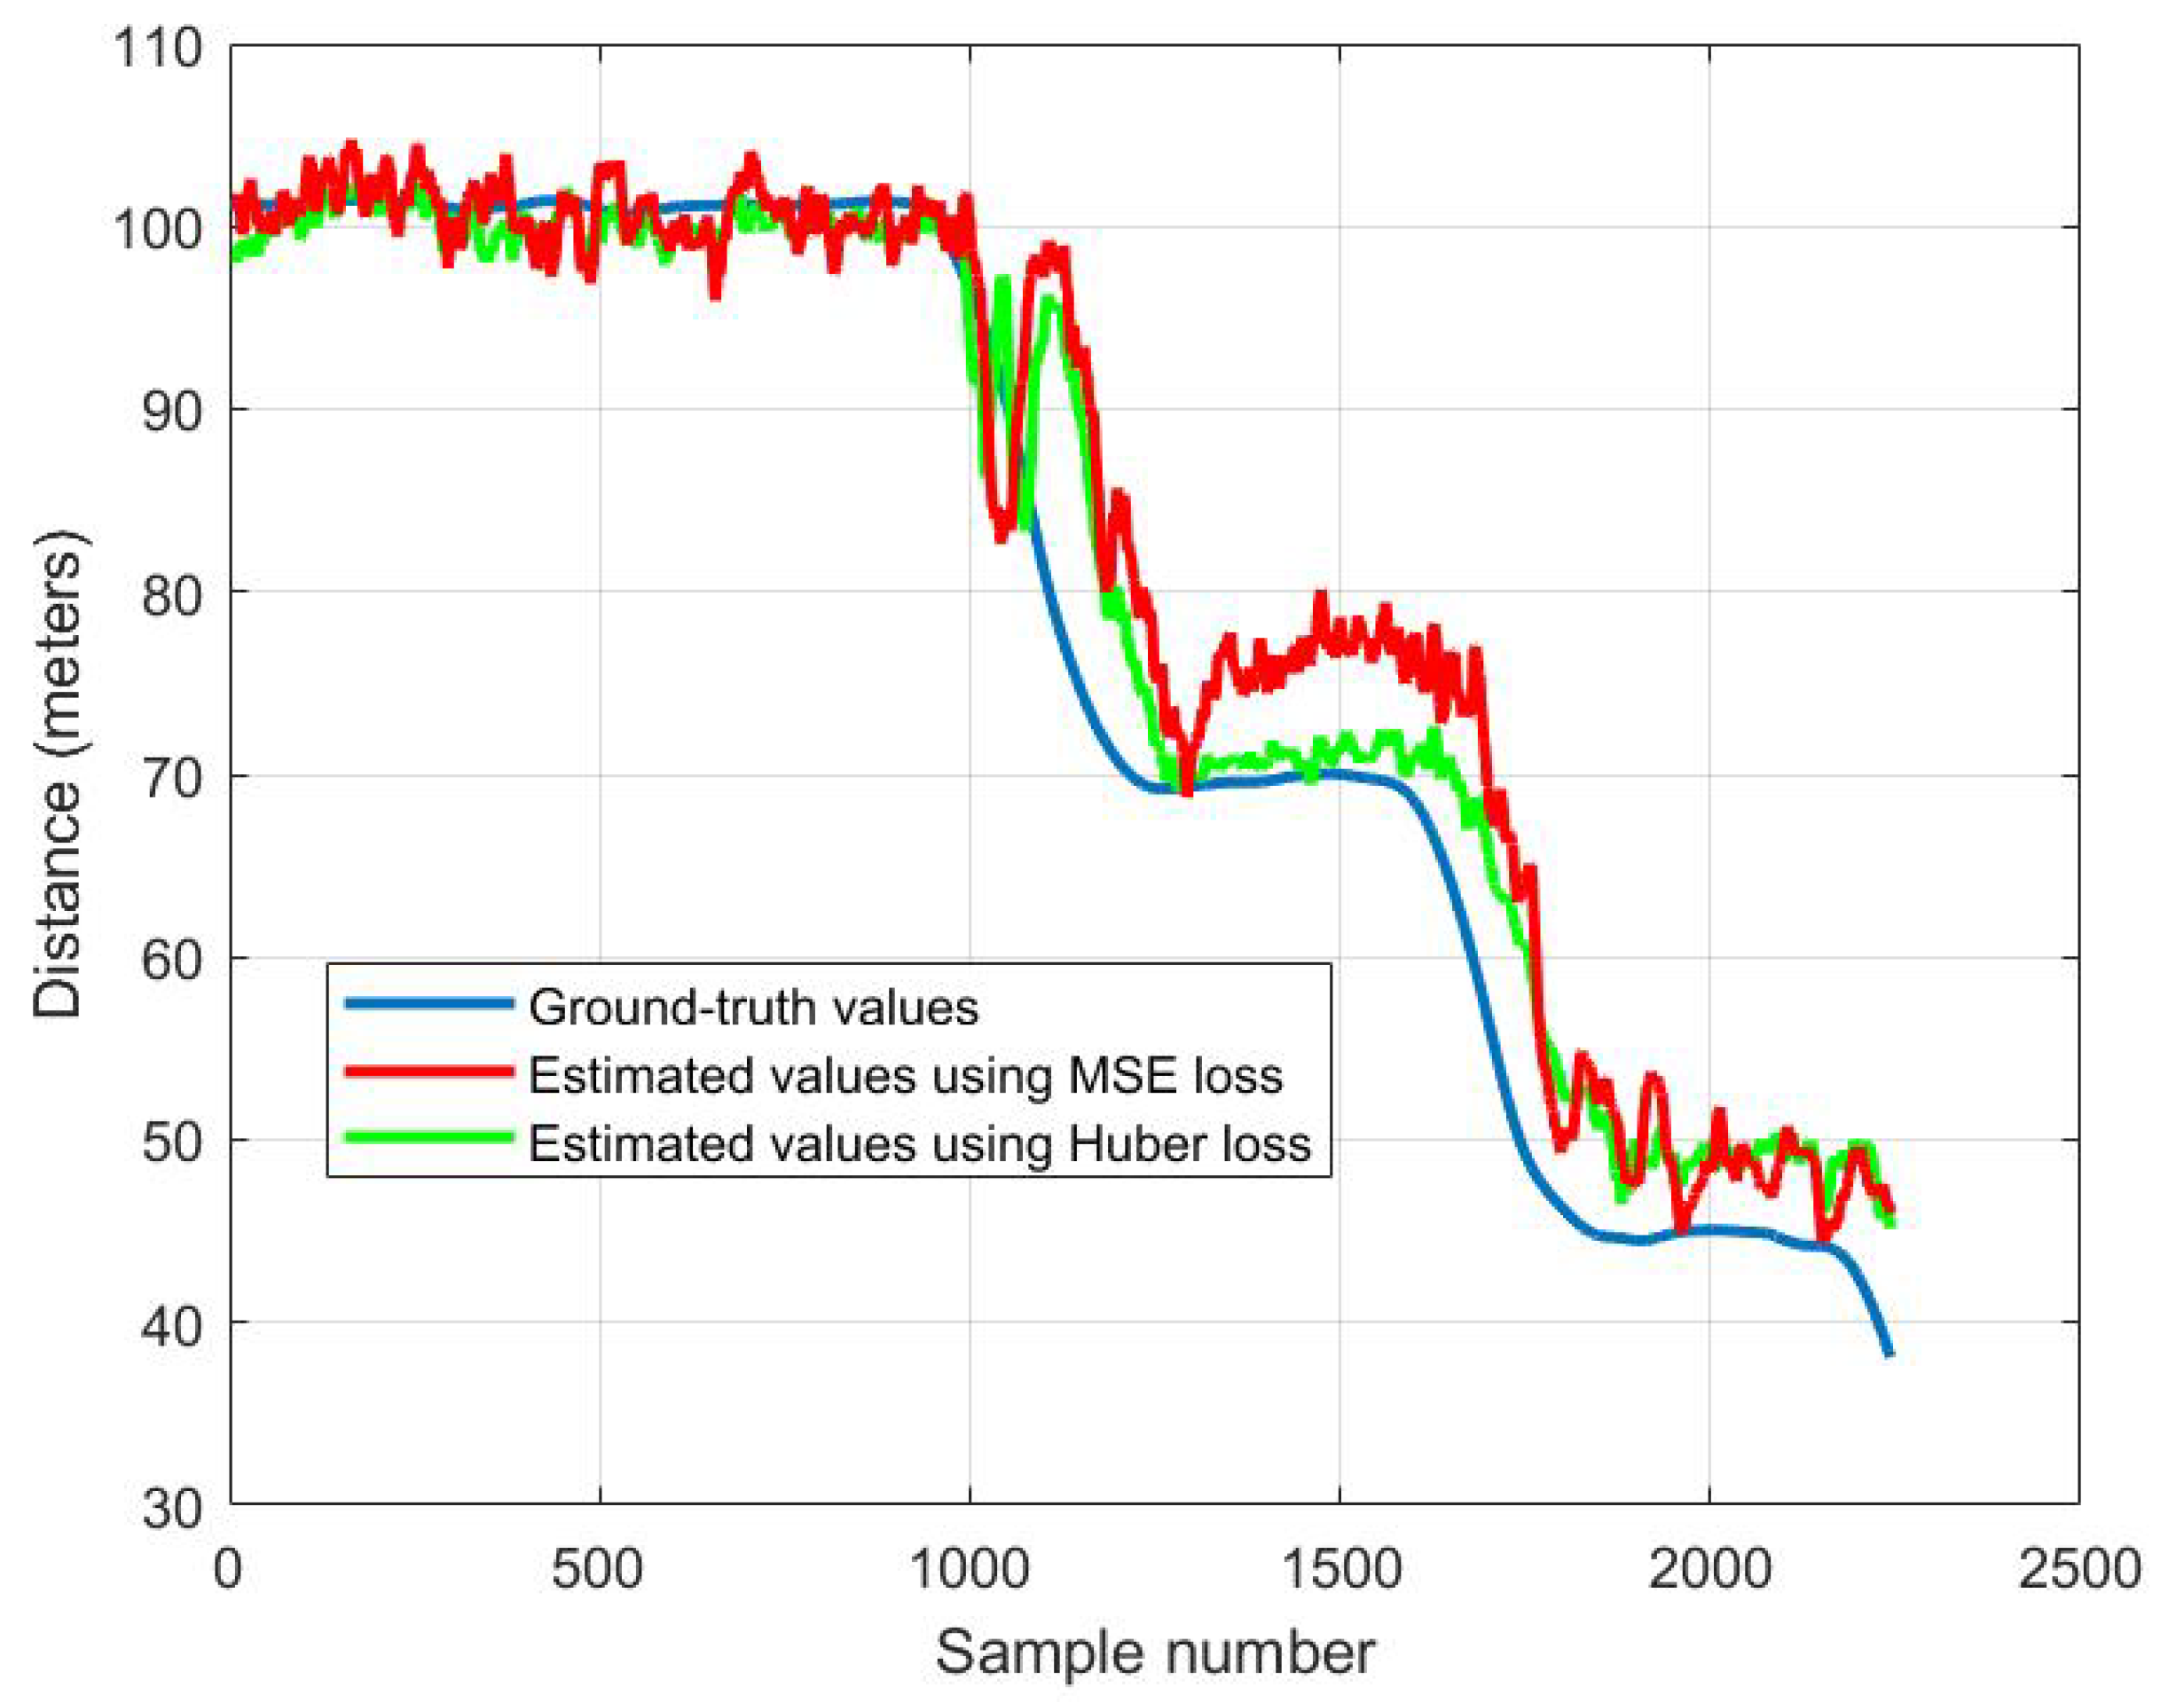
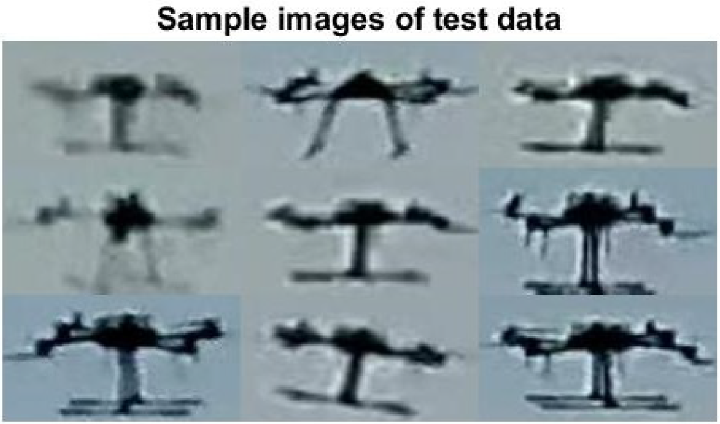
Performance analysis (cont’d)
Experimental data
1860 frames for training
2243 frames in tests
Introduction
Problem definition
Proposed method
Performance analysis
Conclusion & future works

Slide 14
Conclusion
A novel method for drone distance estimation employing a 4-layer deep convolutional network
Not estimate the distance using only the number of pixels based on the simple pinhole model (which in not valid in some cases such as oriented drone)
Incorporating the actual bounding box size in addition to the cropped image within the bounding box as the input
The simple architecture of the CNN network, coupled with its low computational load, enables real-time implementation
Further investigations could explore additional factors such as domain shift (in the background, light/weather conditions, and even drone type)
Introduction
Problem definition
Proposed method
Performance analysis
Conclusion & future works
Notes:
A significant challenge in classical distance estimation arises from the orientation of the drone and its impact on the number of pixels it occupies in the captured image (i.e., we can not only rely on the occupied number of pixels and compare it to a reference case to estimate the distance). The classical approach needs also a reference case to extract the coefficient which shows the relation between the number of occupied pixels and the distance (we do not have such information for the target intruder drone)

Slide 15
THANK YOU
Corresponding author: Hamid Azad
(hamid.azad@uottawa.ca)

